Slide 1



How AI is Changing IoT
AI & RTLS: Turning Shopfloor Data into Instant Answers
Inpixon.com
Notes:
What if your factory could talk to you? What if, instead of analyzing dashboards, you could simply ask: ‘Where is my bottleneck?’

Slide 2
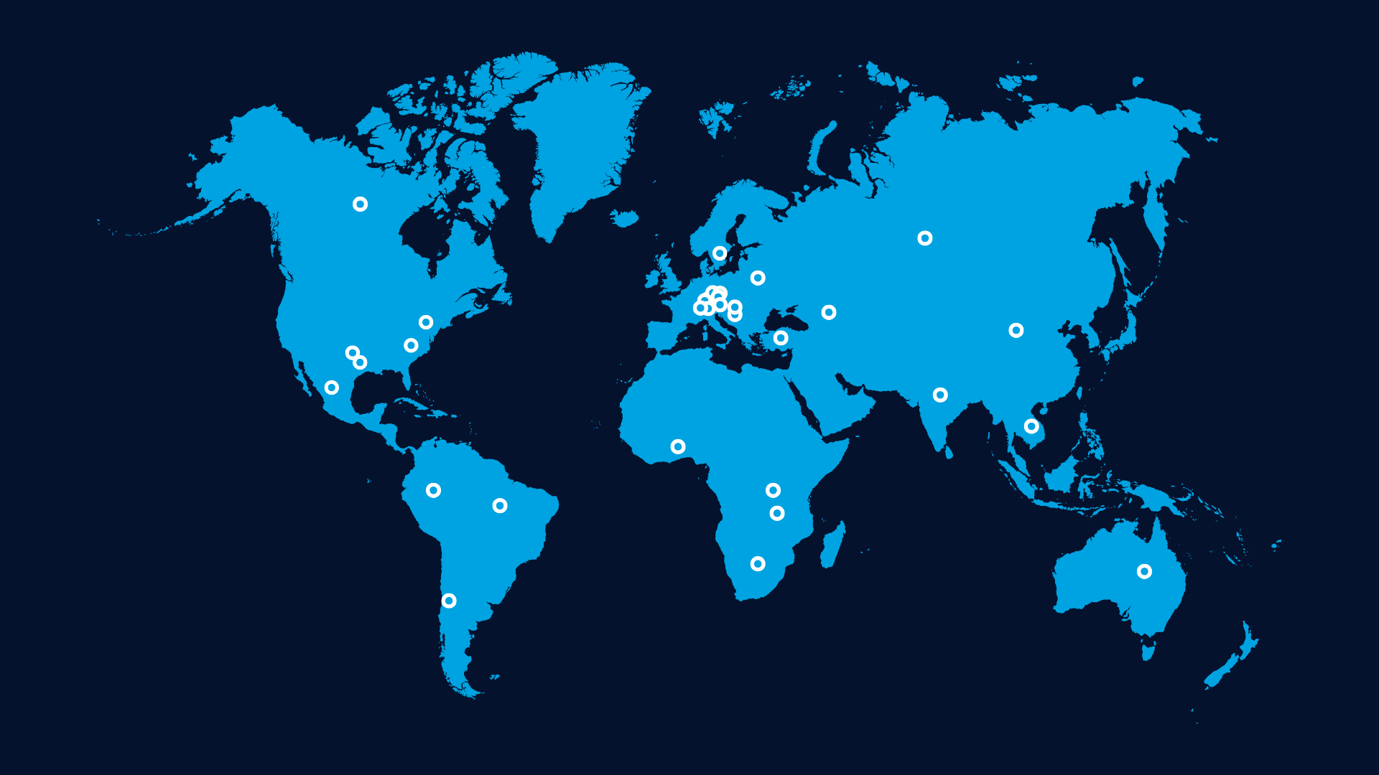

A Global Leader in Location Intelligence and IIoT Solutions
Customer Projects Around the World
About Inpixon
  Successfully delivering solutions to the market for over
  25 years
  Pioneer in location-based automation and digitalization
  Award-winning open solution platform and technology
  Millions of products deployed in the field
  Renowned customers from automotive, engineering, aerospace, and logistics industries
  Global partner and service ecosystem
  A division of XTI Aerospace, Inc.
© Inpixon | All Rights Reserved | Inpixon.com

Slide 3


Where We Come From –
Enabling Smart Production & Intralogistics With RTLS & IIoT
Real-time asset tracking for tools, equipment, vehicles, and personnel
Intelligent automation to replace manual processes
Location-based analytics for workflow and efficiency optimization
Reduce Downtime & Costs – Minimize search times, setup losses, and delays
© Inpixon | All Rights Reserved | Inpixon.com
Notes:
🎤 Storytelling-approach:
"For years, factories and logistics centers have relied on experience, intuition, and static reports to manage their operations. But in an environment where every second counts, real-time visibility and automation are the true game changers.“
💡 That’s where we come in.
.
.
.
.
📢 Key Transition Statement for next slide (Use Cases):
"RTLS and Digital Twin technologies have already transformed industrial operations. But how exactly? Let’s take a look at real-world use cases."

Slide 4

Know More, Wait Less, Produce Faster - With Location & IIoT Data
Intralogistics & Production Tracking
Location- & IIoT-Based Automation
Analytics & Process Optimization
Always know where your materials, tools, and equipment are.
Eliminate manual processes with real-time location intelligence.
Transform data into actionable insights to optimize workflows.
Reduce search times by up to 80% – Workers instantly locate what they need
Track material flow in real-time
Monitor vehicles, load carriers, pallets, and material across production & warehouses
Reduce manual scanning by up to 85% — No more barcode scanning
Trigger workflows based on movement, geofences, and process rules
Automate material replenishment to avoid shortages
Identify inefficiencies in workflows and material handling by up to
30-50%
Heatmaps, trails & dwell-time analysis reveal congestion & idle time
Spaghetti diagrams & route optimization improve efficiency
© Inpixon | All Rights Reserved | Inpixon.com

Slide 5
RTLS Tells You Where – AI Tells You Why
The Challenge Today:
Too much data, not enough insight – RTLS generates vast amounts of data, but turning it into real-time decisions is still a challenge.
Static dashboards are outdated – Traditional BI tools require manual analysis, slowing down decision-making.
We need intelligence, not just information
What if operators and managers could simply ask about their shopfloor - What’s happening and what needs to be optimized?
© Inpixon | All Rights Reserved | Inpixon.com
Notes:
RTLS has already transformed visibility and automation in the industry. But what if we could go beyond tracking? What if we could understand what’s happening on the shopfloor – and even predict what will happen next?
That’s why we’re taking the next step: AI-powered RTLS, making data not just visible – but actionable.

Slide 6

The Next Step?
Making RTLS and Shopfloor Data
Truly Interactive
© Inpixon | All Rights Reserved | Inpixon.com

Slide 7
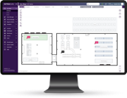
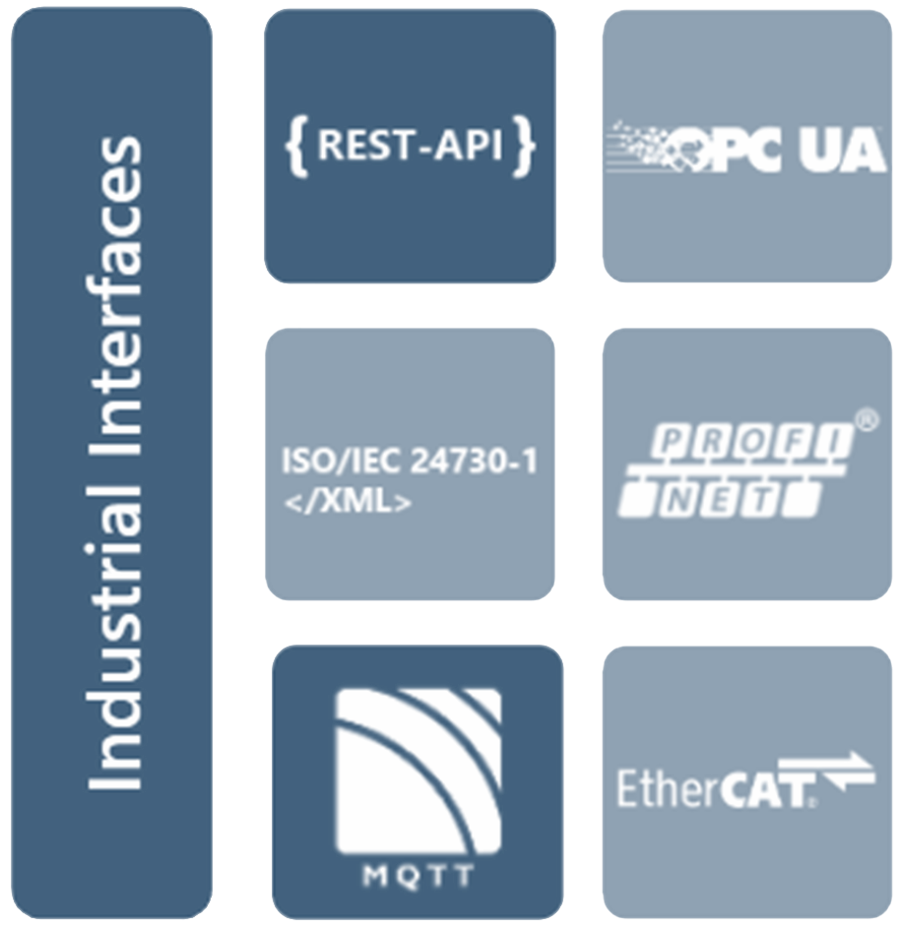
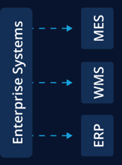
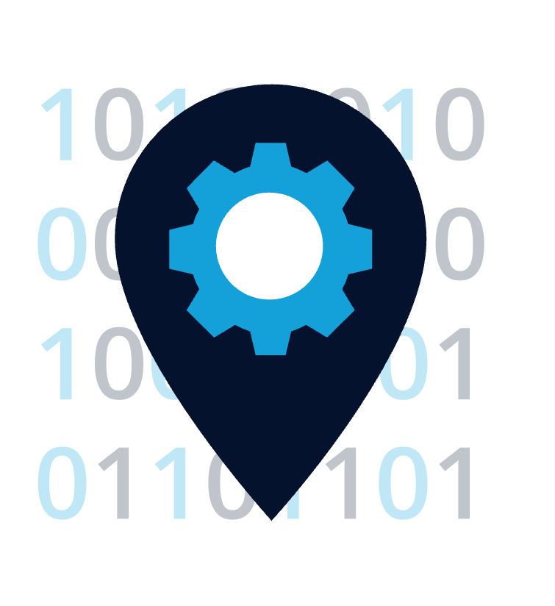


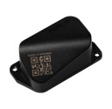
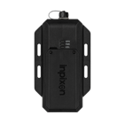

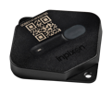






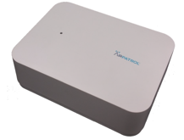
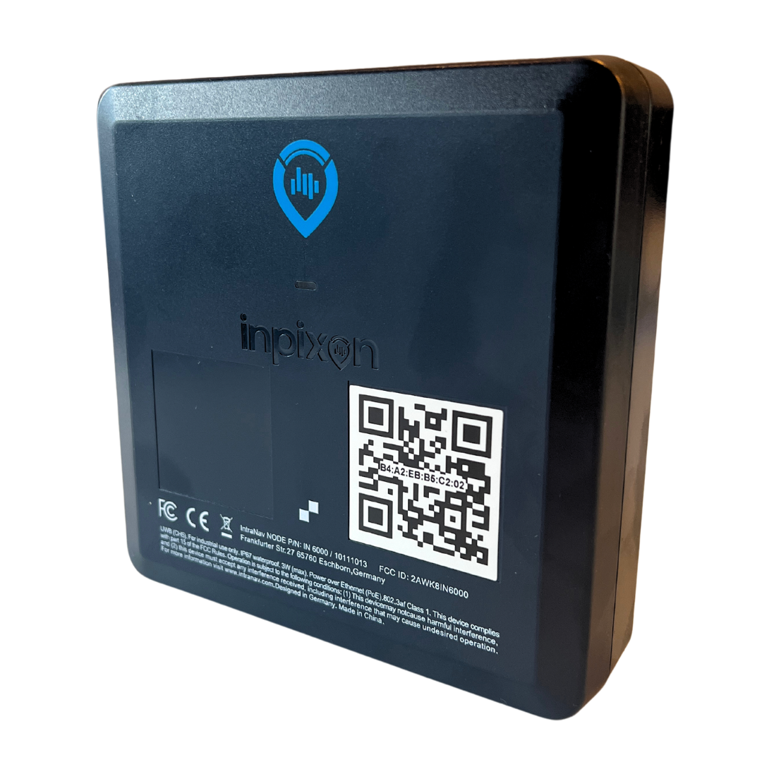



Inpixon Product Portfolio
Complete and flexible RTLS & IIoT-Stack
Solutions
Inpixon IoT Platform & LE
- Smart Factory Module
- Smart Warehouse Module
- Smart Mining Module
- Smart Facilities Module
Standard Industry Interfaces
On-prem/ cloud
Multisite
Vendor independent
Wirepas
Infrastructure
Tags (In- Outdooor, Bat/Rechargable
Anchors (In- Outdooor, ETH/ Wireless)
Device Detectors (Security)
Chirp
3rd Party Infrastructure
NFC
BLE
RFID
GPS
(BLE, Wi-Fi, IR, RFID)
UWB
QR Codes
Wi-Fi
E-Ink
LiDAR
© Inpixon | All Rights Reserved | Inpixon.com

Slide 8

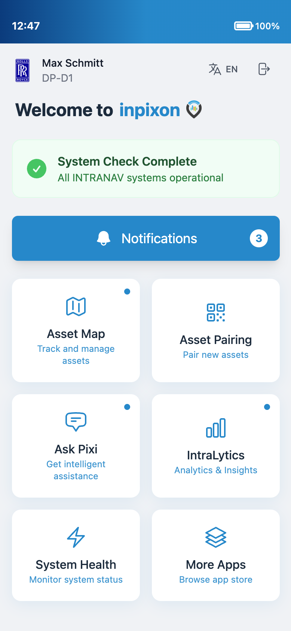
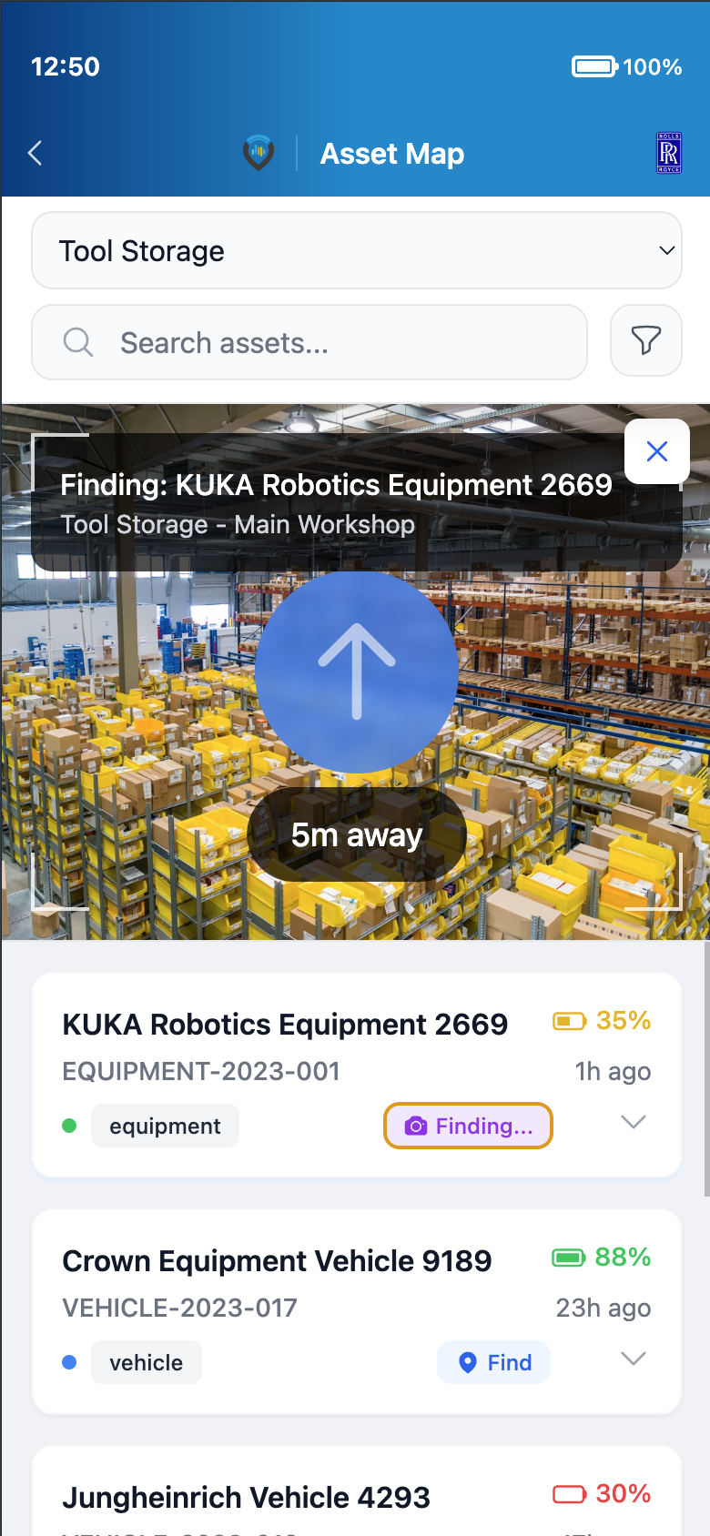

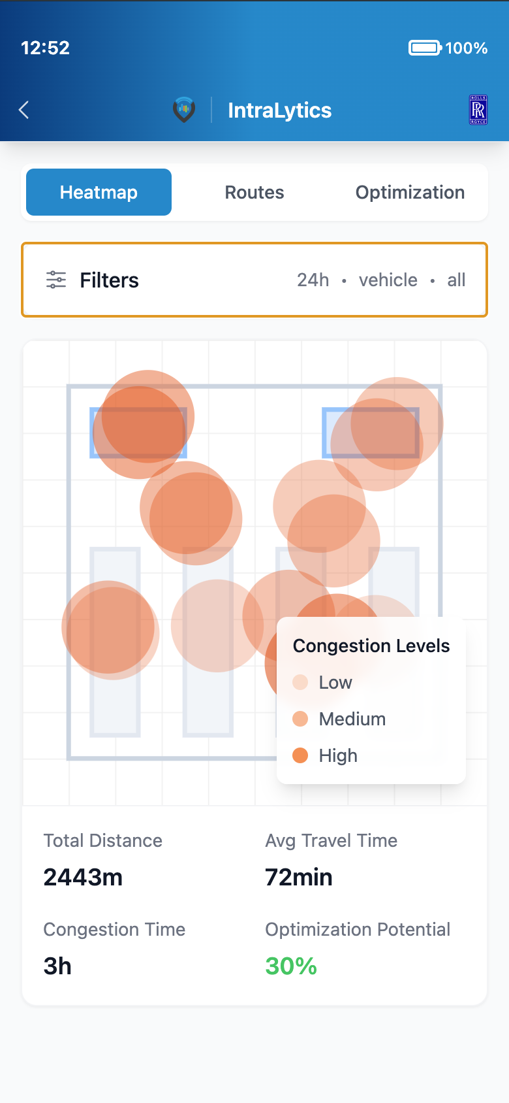
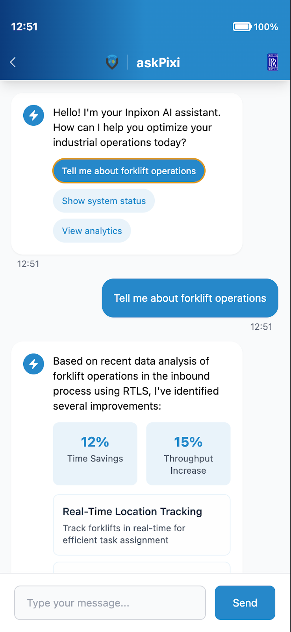
Inpixon AI Product Portfolio
All new Factory Intelligence Roadmap
All new mobile App
Feel heartbeat of your Factory
All new Track & Trace Experience
New tools for keeping up efficiency
AI powered Solutions
On-Time Delivery
Shopfloor optimization
OEE optimization
Quality improvement
Production throughput enhancement
Impactful Factory Analytics
Stay competitive with impactful insights
askPixi!
Powerful Ai for better planning and forecasting
© Inpixon | All Rights Reserved | Inpixon.com

Slide 9
askPixi!
Interact with your Factory like never before
Ask about improvements
Utilizes RTLS and can apply Kaizen! Continues improvement. Shop floor optimizations.
Planning support
Get notified when planning adjustments are required. E.g impacting on-time delivery.
© Inpixon | All Rights Reserved | Inpixon.com

Slide 10




Let’s Talk
Transform Your Factory with Inpixon AI
hello@inpixon.com
inpixon.com
inpixon.com/contact-us
© Inpixon | All Rights Reserved | Inpixon.com

